Slide 1
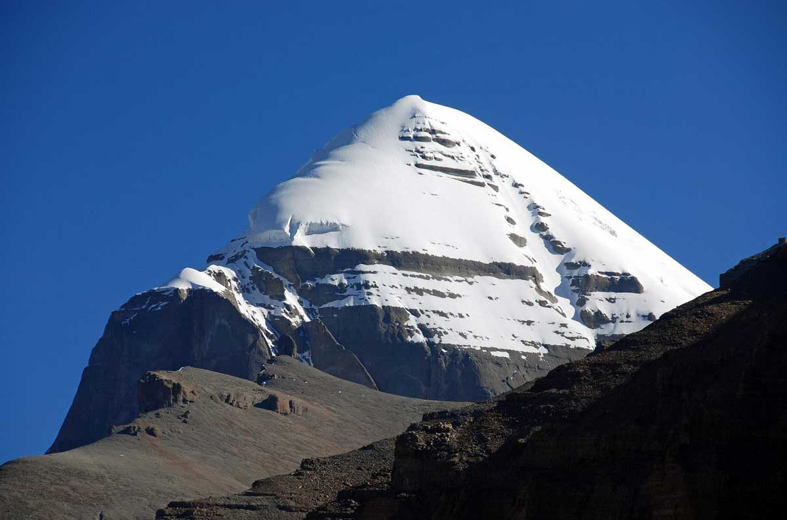

i-UG community Keynote
Building and Managing a User Group
Mike Ryan – i-UG Chairman
Notes:
You will hear from each of the Board Members now

Slide 2
Building and managing a User Group
It sounds easy when you say it quickly…
It always feels like you are climbing a mountain
What you can’t see in this image…
Why do we do it?
Let’s have a look at: -
  What is i-UG
  What our Core Values are
  The key players and their jobs
  Just one of the initiatives (STEM)
Notes:
Colin and I – Lonely
Seamus Quinn
Journey, not a destination
SB joining was big impact
We have come a long way

Slide 3

What is i-UG
“A community of like-minded technicians and IT Management”
There to: -
  -generate benefit to Members
  -evangelise the platform
  -get the word out to a larger audience
  -deliver education, education, education
  -bring people together
How?
  Close Board (Specific Term-based Responsibilities)
  Hands-on Committee
Support from:-
  Members, IBM, Vendor Members, Experts
Funded through: -
  Subscriptions, sponsorships
Partnering appropriately: -
  Education organisations, publishing organisations, marketing organisations

Slide 4
History
Established in 1993
We started as a Not for Profit organisation called NASUG
  AS/400
Changed to NiSUG
  iSeries
Merged with CUA and re-christened ourselves i-UG
Member of Common Europe since 2010
  Common UK
27 years face-to face
  Last year ranged from Virtual to Hybrid

Slide 5
Core Values
Above all else, we are not controlled by any outside entity
  -not IBM
  -not large ISVs
  -not Business Partners
  -not Sponsors
  -not Board Member Organisations
We do not tolerate sales oriented presentations
We insist on education oriented presentations
We encourage primarily IBM i centric content
We are open to technologies that support
our members installations
i-UG is driven by passion, not payroll
  Neither Board nor Committee are on a payroll!
(incurred costs are covered)

Slide 6
The Management Team
The Board
Secretary and Treasurer
  Managing funds
  Organising and minuting meetings
  Dealing with the Membership
  Position currently held by Colin Spofford
Technical Director
  Technical direction for Group
  Liaison with IBM at high level
  Check and Balance for all things technical
  Side benefit – leading international speaker…
  Position Currently held by Steve Bradshaw (Brad)
Marketing Co-Ordinator
  Rationalise our messaging
  Manage our marketing strategy… and feedback
  Drive Educational Event promotions
  Position currently held by Steve Cast
Chairman
  Coordinate the group
  Position currently held by Mike Ryan
The Committee
All equal status, no permanent responsibilities
  Currently:
    Eddie Chaffin, Terry Bartlett, Sam Dix, Will Holland, George Willmott, Ron Hack… Open to more…
Notes:
You will hear from each of the Board Members now

Slide 7
Steve Bradshaw (Brad) – Technical Director
Notes:
You will hear from each of the Board Members now

Slide 8
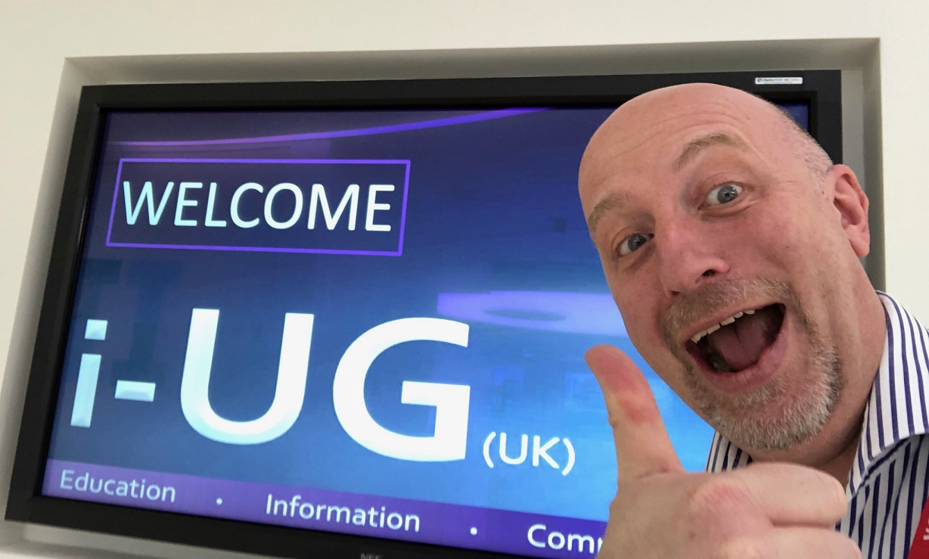
Remember User groups make you happy!
They MAY NOT make you more attractive
They MIGHT make smarter
They WILL make you sound smarter
SUPPORT YOUR LOCAL USER GROUP

Slide 9
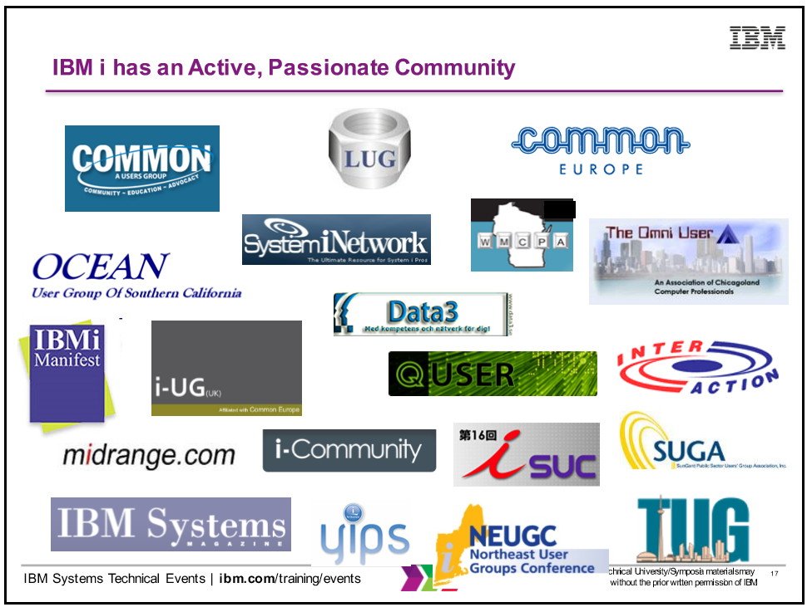


IBM i is a platform like no other
  So far I have found 52 IBM i user groups
  I’m told there are many more.
  They are literally a goldmine of information
  Their members are wonderful people

Slide 10
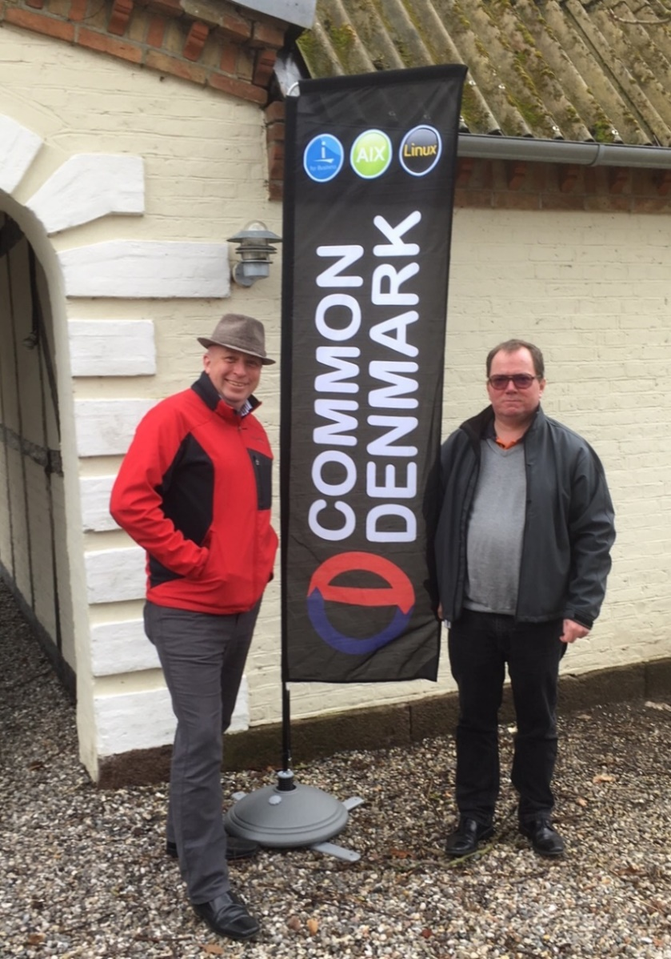
One day we will be able to travel again
  Make contact, drop in on an event

Slide 11
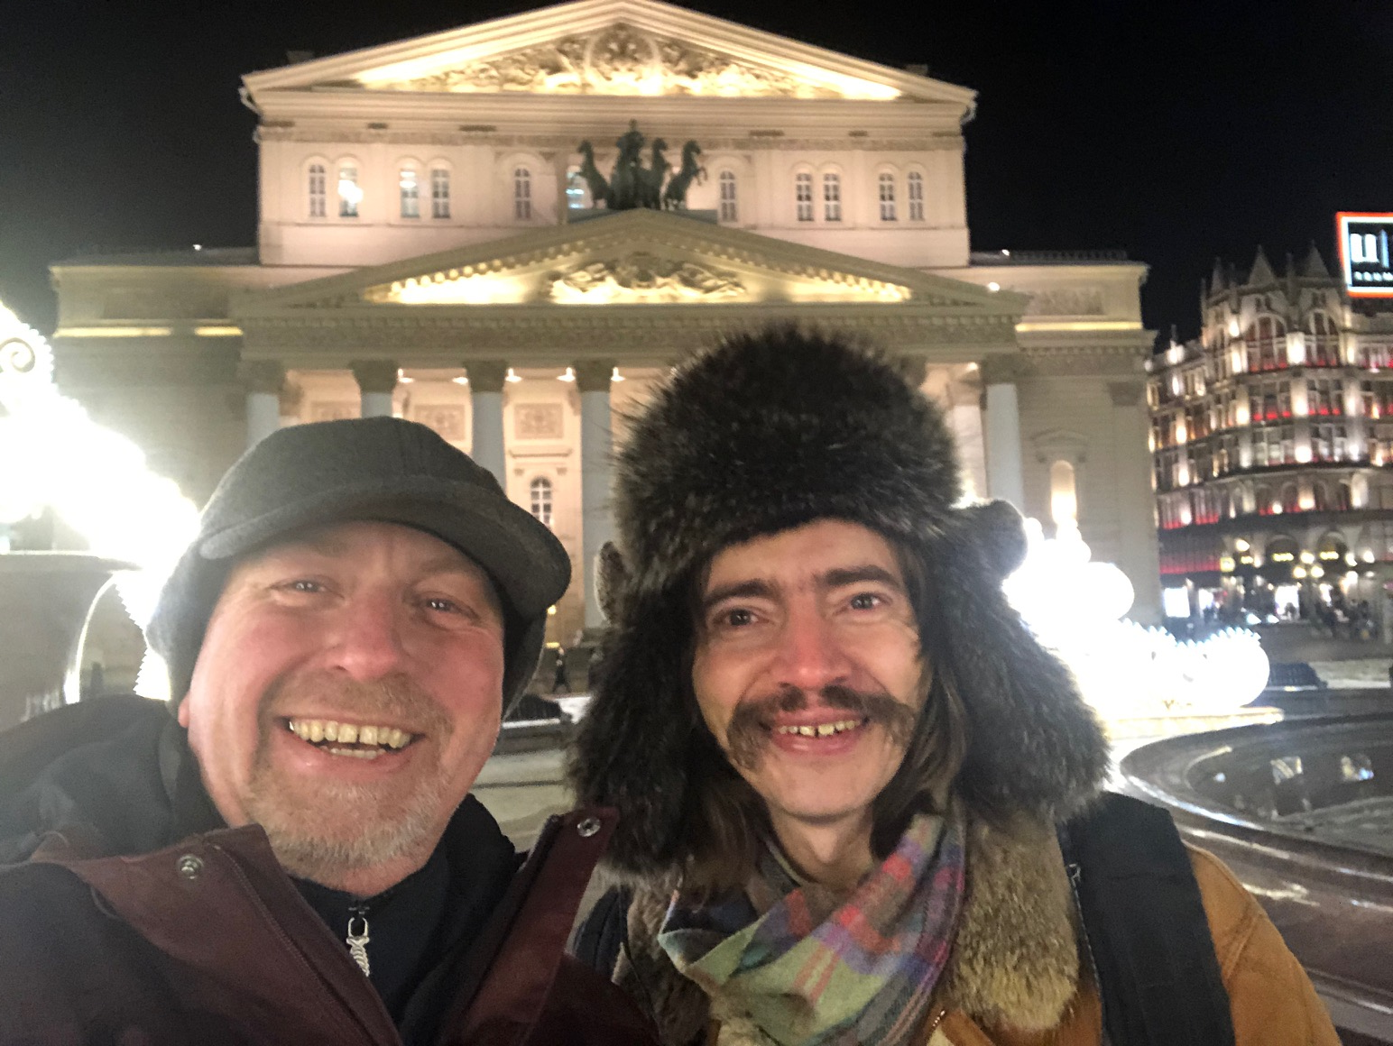
Make learn more than just IBM i skills

Slide 12

Practice what we preach
i-UG event management running on IBM I
Delivering IBM i for a iPower events
Next we plan to make IBM i available to you
Virtual loan IBM i LPAR for members

Slide 13
What we talk about
How do we decide what to talk about?
i-UG committee
Feedback from i-UG members
IBM Champion Program
CEAC – Common Europe Advisory Council
IBM RFE website
Other Common Organisations
Online articles such as PowerWire
IBM Early Adopter (Beta Test) Program

Slide 14
Our Speakers
How do we get speakers?
Because of you they come to us
How do we discover new speakers
You tell us, so please keep telling us!

Slide 15
What else do we do
Officially we call it networking
You meet the sponsors, the members
Unofficially, we are a dating agency
You talk to us and get a recommendation
We help with testimonials, recruitment, …
Help with your RFE’s
Champion your cause via CEAC

Slide 16
Steve Cast - Marketing Co-Ordinator
Notes:
You will hear from each of the Board Members now

Slide 17
Marketing the i-UG – Steve Cast
Why am I here?
  - promote the i-UG across all platforms
  - keep our brand consistent
  - evangelise about our group everywhere
  - deliver benefit to all members:
    Individual
    Company
    Vendor
    Other? Watch this space ….
  - spread the word about events and membership
  - retain membership levels
  - ensure long term financial viability
Notes:
You will hear from each of the Board Members now

Slide 18
Marketing the i-UG – Steve Cast
100 Days in …… The Good, The Bad and the Ugly
  The Good – The welcome, the teamwork and the spirit
  - What a welcoming and supportive group the i-UG are
  - What an amazing team the committee are
  - Our “carry on i-uging” spirit
Notes:
You will hear from each of the Board Members now

Slide 19
Marketing the i-UG – Steve Cast
100 Days in …… The Good, The Bad and the Ugly
  The Bad – Covid, Commitment and Planning
  - Planning a hybrid event is exponentially harder
  - Finding the time. How do Mike, Colin and Brad do it?
  - Taking longer to take stock than expected.
Notes:
You will hear from each of the Board Members now

Slide 20
Marketing the i-UG – Steve Cast
100 Days in …… The Good, The Bad and the Ugly
  The Ugly – Brand Rationalisation Challenges
  No Mike, not our website or graphics, but our hashtag
  #iug
  We are not the international ugly group
  nor are we the Independent University of Geneva,
Notes:
You will hear from each of the Board Members now

Slide 21
Marketing the i-UG – Steve Cast
Done So Far
  Asset and Supplier Review
  - Met with, and continue to review, our social media partners
  - Refreshed the website and taken ownership of this asset
  - Increased mailings via Mailchimp
  - Promoted March and July Events
Notes:
You will hear from each of the Board Members now

Slide 22
Marketing the i-UG – Steve Cast
Done So Far
  Member Engagement
  Kept our message on point
  Increased membership numbers
  Prevented member attrition
  Met with several Vendor Group Members
Notes:
You will hear from each of the Board Members now

Slide 23
Marketing the i-UG – Steve Cast
Done So Far
  Event Management
  - Assisted Vendor Members for International i-Power 2021(h)
  - Increased event awareness via Mailchimp
  - Visited the venue for International i-Power 2022(h)
Notes:
You will hear from each of the Board Members now

Slide 24
Marketing the i-UG – Steve Cast
Still To Do
  Asset and Suppliers
  - Review value from our social media partners
  - Consider the website relaunch/brand for 2022 onward
Notes:
You will hear from each of the Board Members now

Slide 25
Marketing the i-UG – Steve Cast
Still To Do
  Member Engagement
  Increase membership numbers
  Prevent member attrition
  Meet with all Vendor Group Members
  Regular membership comms; by segment?
  Increased membership value; discounts?
Notes:
You will hear from each of the Board Members now

Slide 26
Marketing the i-UG – Steve Cast
Work In Progress
  Event Management
  Plan 2022 events including International i-Power 2022(h)
  Consider focussed/special interest groups
Notes:
You will hear from each of the Board Members now

Slide 27

Marketing the i-UG – Steve Cast
Summary
  - Taking stock took time
  - There is a lot to the role
  - Despite Covid …
  We are still running quality events
  Still engaging with all our members
  - Looking ahead …
  More benefit to all members
  Raise the brand awareness even more
  Increase value to every member
  Carry on i-uging Thanks!
Notes:
You will hear from each of the Board Members now

Slide 28
Colin Spofford – Secretary and Treasurer
Notes:
You will hear from each of the Board Members now

Slide 29
Managing the Funds
Its NOT about the money!!
    Colin Spofford
    i-UG Secretary & Treasurer since 2011
    Member since group began in 1993
Notes:
You will hear from each of the Board Members now

Slide 30
Managing the Funds
Currently in our 28th year
Many of the fundamental principles of the group are still applicable today
Also applies to the financial management of the group
  We are an “Unincorporated Association”
We are a Not for Profit Organisation
We are not a registered charity
We are not registered for VAT
We don’t tick many of the boxes of a commercial organisation
Notes:
You will hear from each of the Board Members now

Slide 31
Managing the Funds
Policy of re-investment
  Benefits to members
    Group awareness
Methods of Funding:
  Membership subscriptions
  Sponsorship of events
  Occasional grants (when available)
Notes:
You will hear from each of the Board Members now

Slide 32
Managing the Funds
Membership options
  Individual
  Company
  Vendor
Notes:
You will hear from each of the Board Members now

Slide 33
Managing the Funds
Individual Membership
  Primarily for an individual consultant or small company
  Or larger company with just one employee who would like to attend events
  Can attend up to 3 events each year FREE of charge
  Access to historic presentation material from previous events
  Offered normally 50% discount on other major events
  If that employee can’t attend one of the events allowed to send a replacement
  No additional charges for lunches or beverages
  Annual cost is just £180 GBP (Unchanged for 7 years)
Notes:
You will hear from each of the Board Members now

Slide 34
Managing the Funds
Company Membership
For larger companies
Same benefits as Individual Membership
  Up to 3 employees can attend up to 3 events each year FREE of charge
50% discount on attendance at other major i-UG events
Can send 3 different people to every event (Just let us know in advance)
Annual cost is just £350 GBP (Unchanged for 7 years)
Notes:
You will hear from each of the Board Members now

Slide 35
Managing the Funds
Vendor Membership (New Kid on the block – Introduced in 2012)
Designed for Service Providers, ISVs & Business Partners etc
Same benefits as Company Membership
Plus
Company Logos and links to landing pages from i-UG web site
Invitations to attend Vendor only meetings
Input into ideas & planning for future events.
In addition we offer a large discount on sponsorship options (more later).
Annual cost is just £500 GBP (First change this year since 2013)
Notes:
You will hear from each of the Board Members now

Slide 36
Managing the Funds
Associate Membership
Looking at this in the future
Designed for people who have moved away from industry or retired
Or possibly students?
Lower level of membership?
Additional costs for attending an event?
Watch this space
Notes:
You will hear from each of the Board Members now

Slide 37
Managing the Funds
In 2008 we decided we had to change a few things
Increase awareness of group
Increase attendances
Increase members
Without increasing cost to members
Introduce an annual “Flagship” conference
More educational sessions
Expo area to allow Exhibitors/Sponsors
Increased revenue
  Increased marketing
  Utilise external resources to handle complexity & marketing
Notes:
You will hear from each of the Board Members now

Slide 38
Managing the Funds
Longer term benefits of Flagship conference
More Education
International Speakers
Deep Dive Hands-on workshops
Invest in Social Media Marketing
Re-brand all i-UG meetings & conferences
Increase membership
Introduce a “fun” element to events
  Different venues
  Gala Dinners
  Prizes
  Entertainment
  Visits to Computer Museum in Manchester
  National Museum of Computing (Bletchley Park
Notes:
You will hear from each of the Board Members now

Slide 39
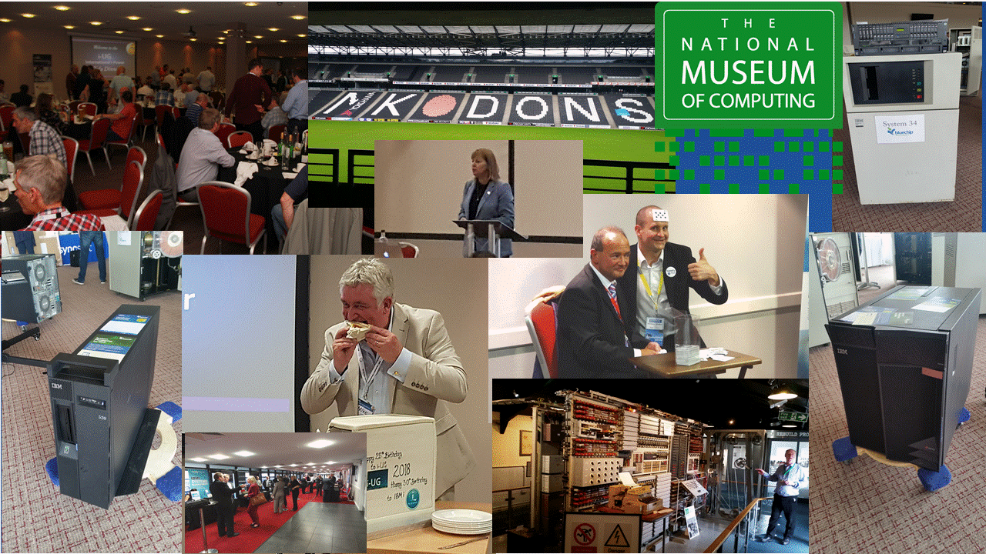

Slide 40
Managing the Funds
Some challenges for the future…..
Live conferences or virtual?
Open or closed meetings?
Free or pre-paid membership?
Additional Benefits for members
Notes:
You will hear from each of the Board Members now

Slide 41
Managing the Funds
Fundamental values still the same
Independent
Not for Profit
Education focused
https://www.i-ug.co.uk/how-to-become-a-member
Notes:
You will hear from each of the Board Members now

Slide 42
Just to close…
Notes:
You will hear from each of the Board Members now

Slide 43


Recent Activity… stalled
  STEM
      Last year i-UG announced plans to get involved in: Science, Technology, Engineering & Maths activities
      Mike, Steve & Colin now STEM Ambassadors
      Now Eddie Chaffin of ABP is an Ambassador
      Encouraging other members to do same
      Carried out first group activity late 2019
      Hope to restart activities in 2021

Slide 44
To sum-up…
A great deal of work is done by the Board and the Committee in the background – FOC
YOU can all help by helping to spread the word about i-UG
Any of you can get involved - part time or more – by joining in on
Committee meetings where you can… or even volunteering to
join the Committee…
Notes:
You will hear from each of the Board Members now

Slide 45
It is YOUR User Group…
It is YOUR i-UG…

